Slide 1





PROJECT ACHIEVEMENT PORTFOLIO
BAYU BUDIANTO
.Net Software Developer

Slide 2




CONTENTS OF THIS PORTOFOLIO
These are the few list Application that I had developed
SIPP (Sistem Informasi Pelaporan Perusahaan)
PPOnline.
Online Booking.
Meeting Room.
Meikarta Property System.
Human Resources Information System
GudangX
NewPerhiasanX
iConverter
PKU Fits
Inventory RepairPart for Hiba Group

Slide 3
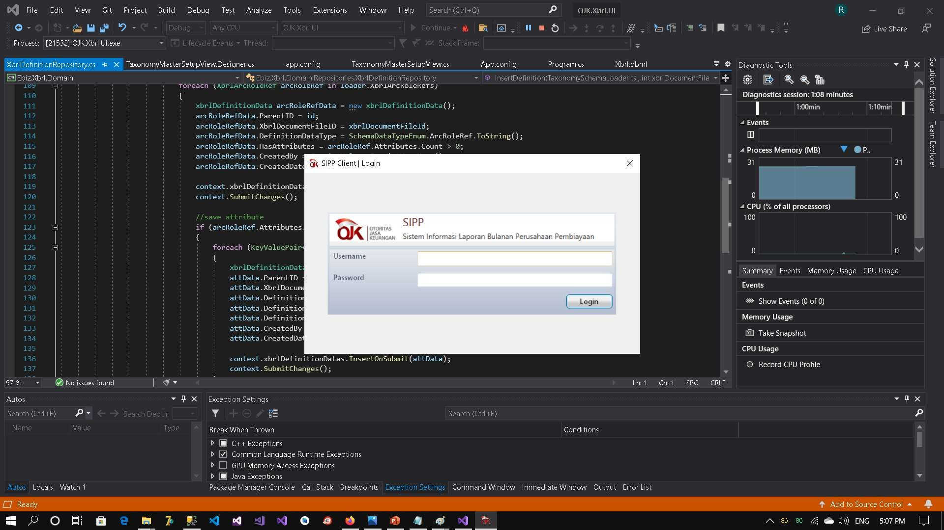
SIPP (SISTEM INFORMASI PELAPORAN PERUSAHAAN

Slide 4
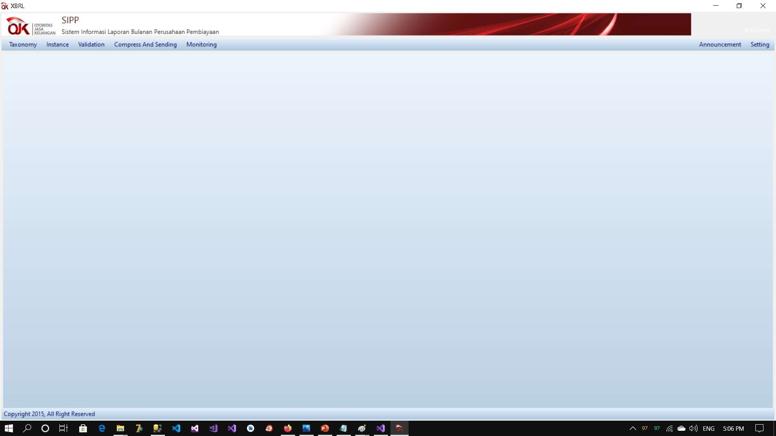
SIPP (SISTEM INFORMASI PELAPORAN PERUSAHAAN

Slide 5
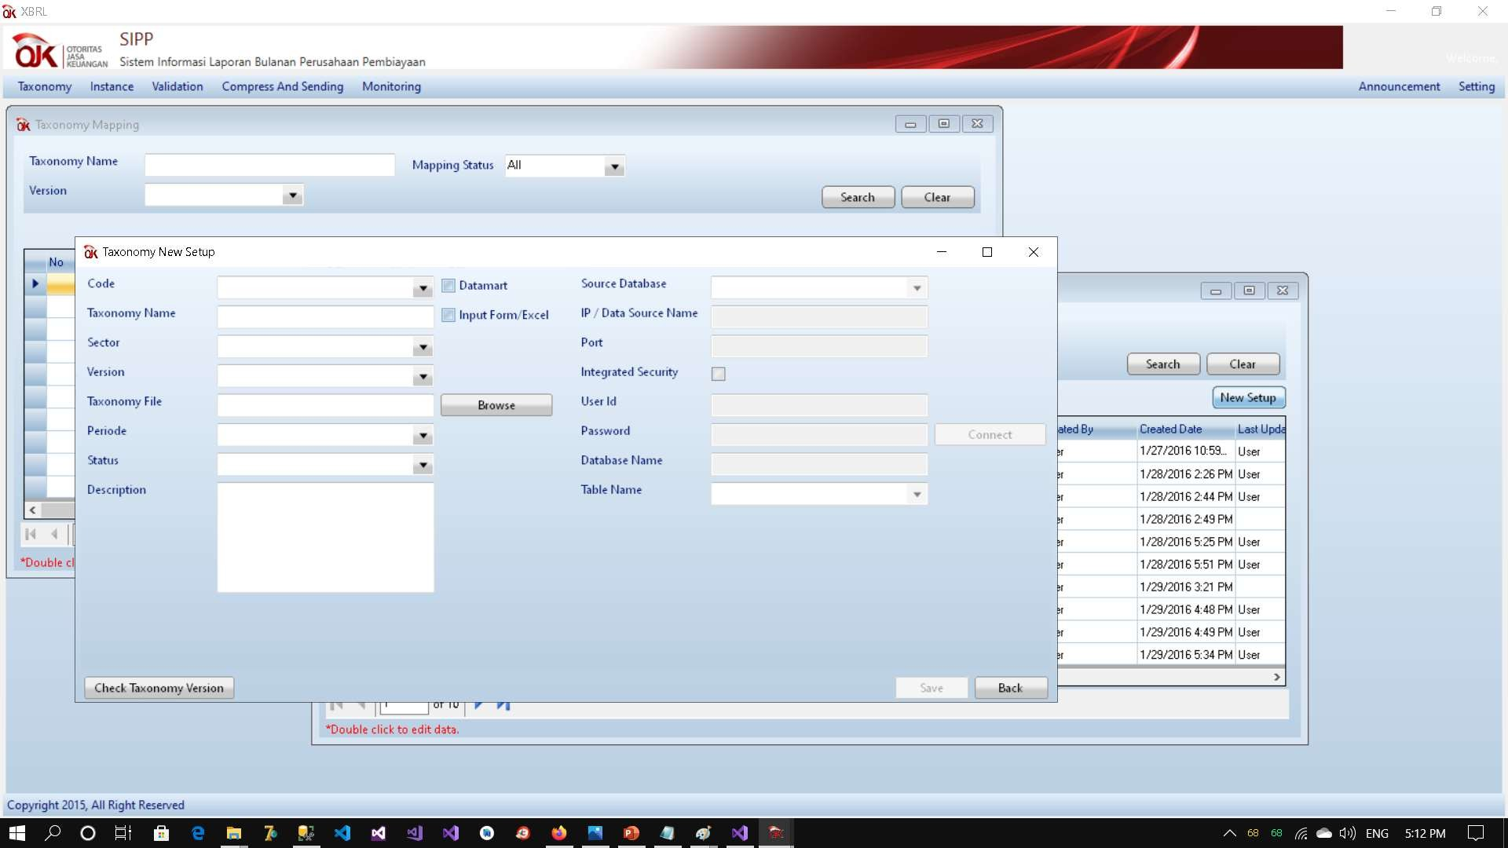
SIPP (SISTEM INFORMASI PELAPORAN PERUSAHAAN

Slide 6

PROJECT DESCRIPTION
Sistem Informasi Pelaporan Perusahaan
.NET Framework 4.6
Entity Framework 6 Design Based
Desktop Application with C# Language
XBRL Reporting
SQLite and SQL Server

Slide 7
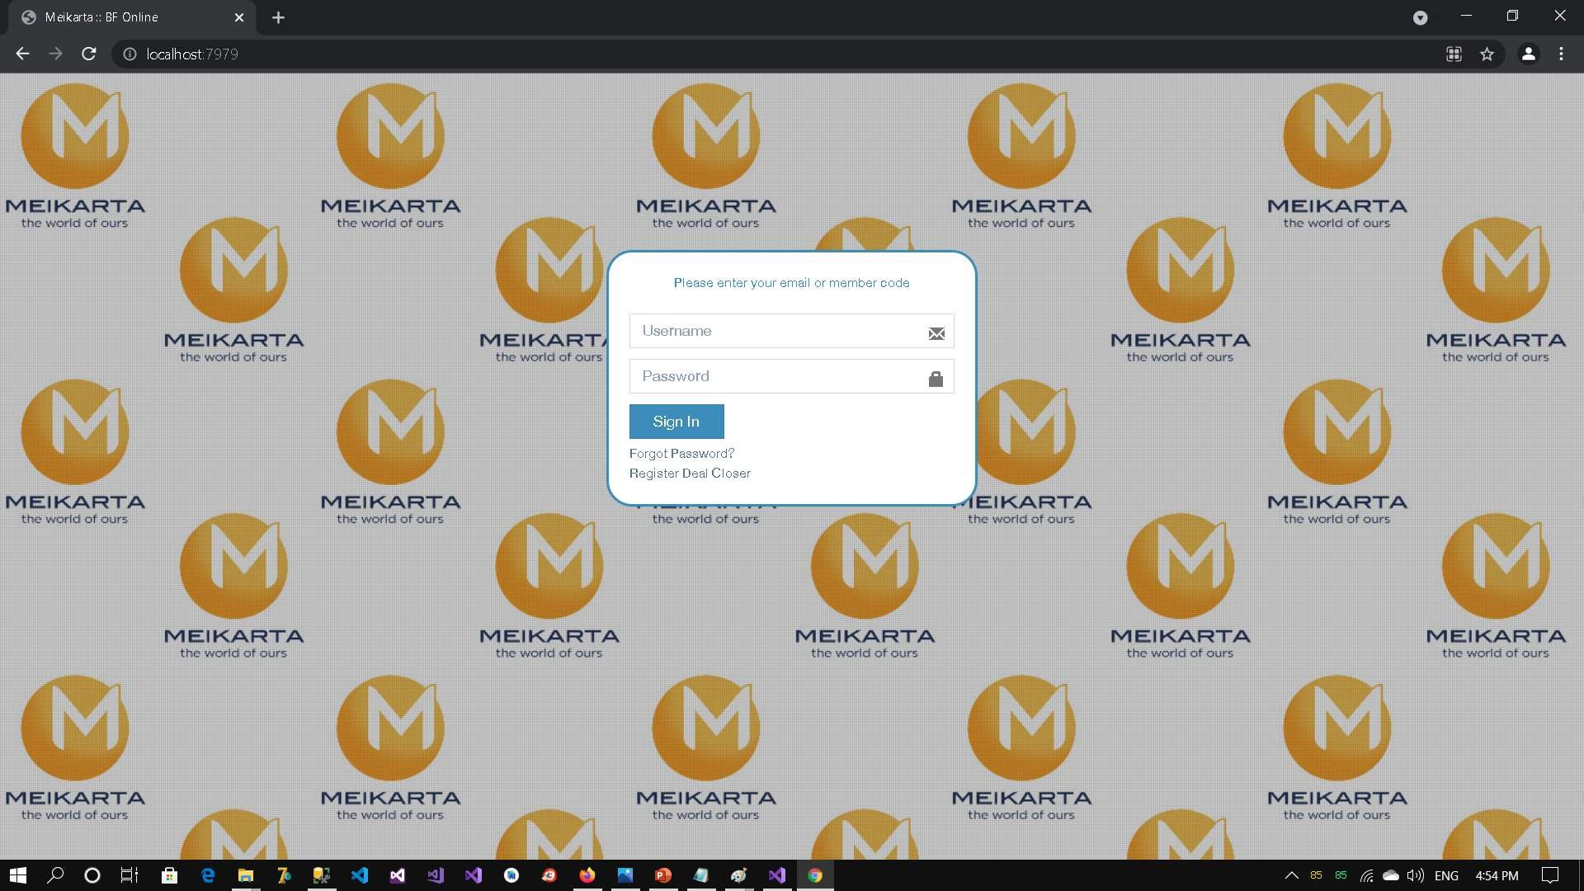
PPOnline - Meikarta

Slide 8
PROJECT DESCRIPTION
PPOnline
.NET Framework 4.6
ADO .NET
Web Form ASP .NET
C# as Language
SOAP WebService
SQL Server

Slide 9
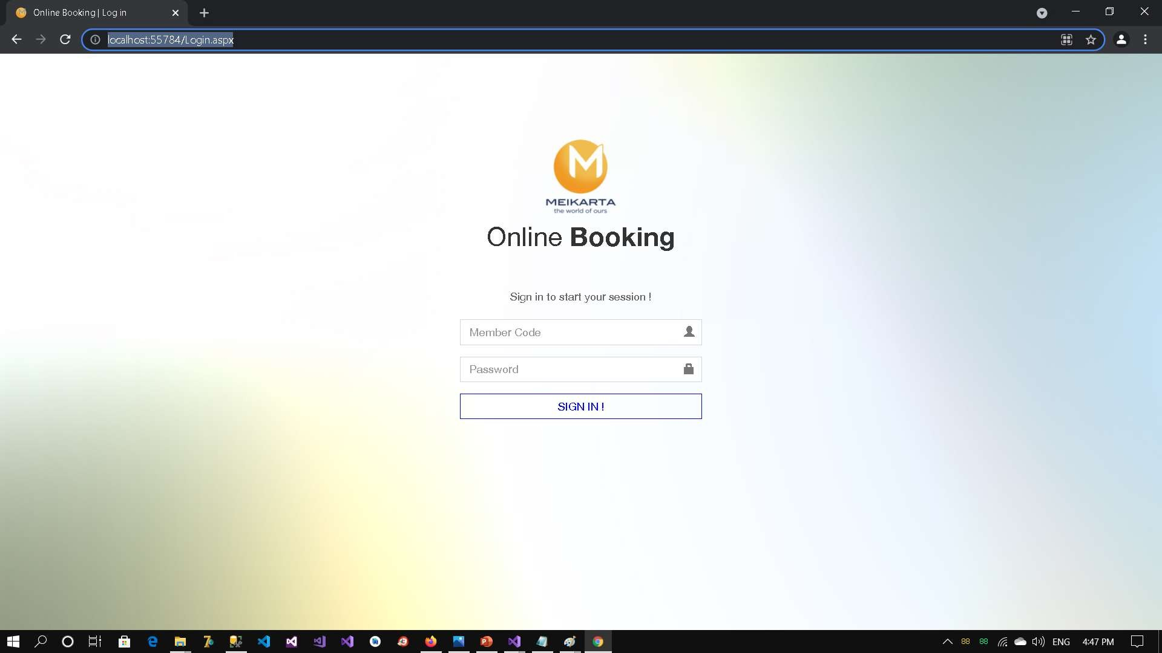
Online Booking - Meikarta

Slide 10
PROJECT DESCRIPTION
Online Booking
.NET Framework 4.6
ADO .NET
Web Form ASP .NET
C# as Language
SOAP WebService
SQL Server

Slide 11
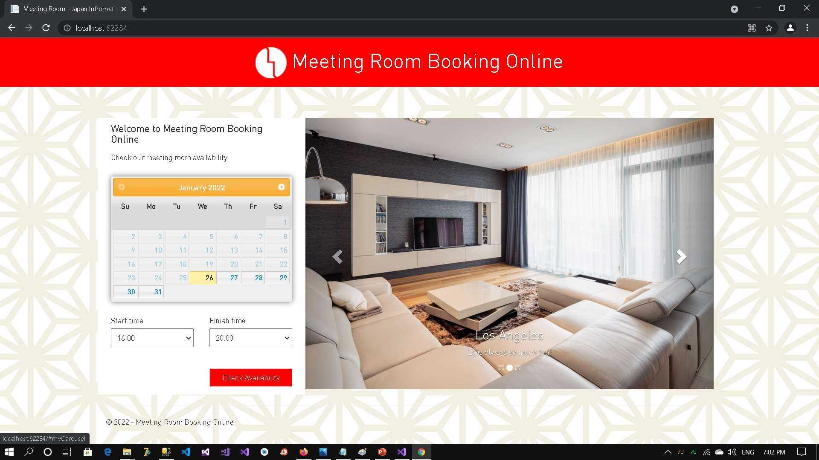
JIC MEETING ROOM

Slide 12
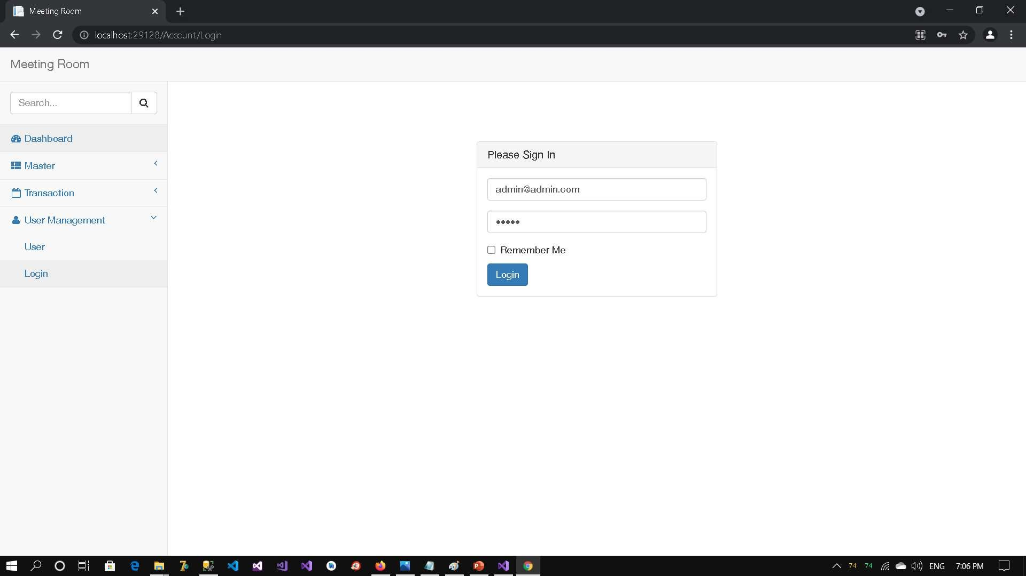
JIC MEETING ROOM

Slide 13
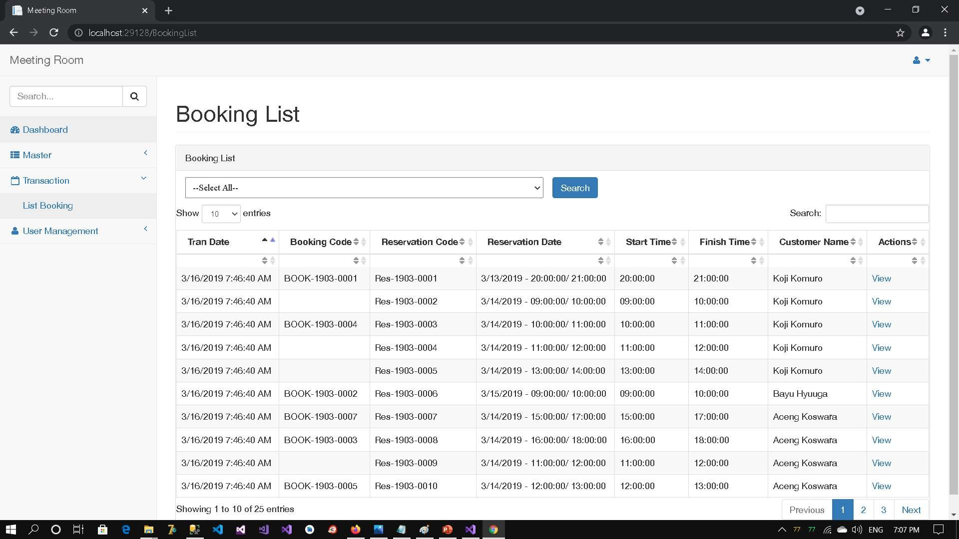
JIC MEETING ROOM

Slide 14
PROJECT DESCRIPTION
JIC Meeting Room
.NET Framework 4.6
Entity Framework 6 Design Based
ASP .NET MVC with C# Language
SQL Server

Slide 15
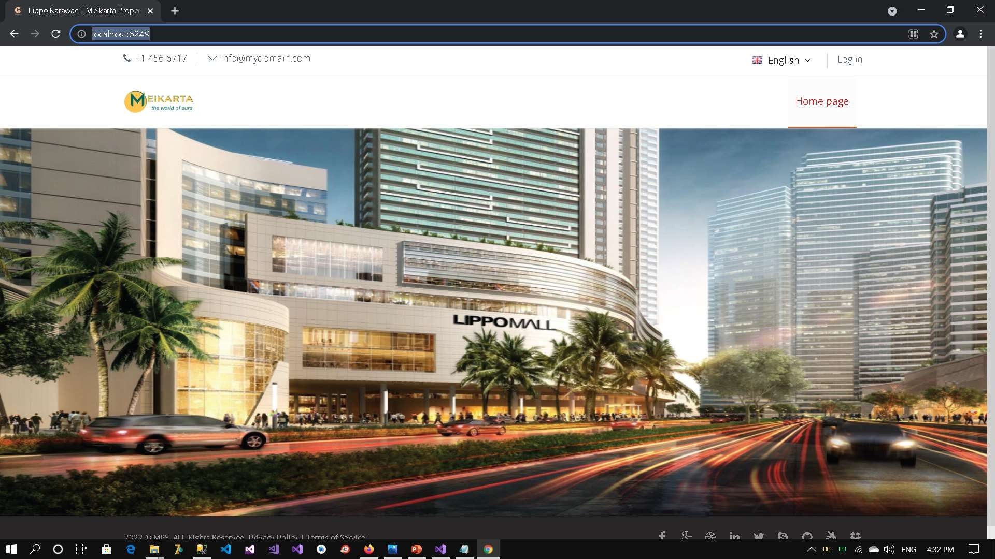
MEIKARTA PROPERTY SYSTEM

Slide 16
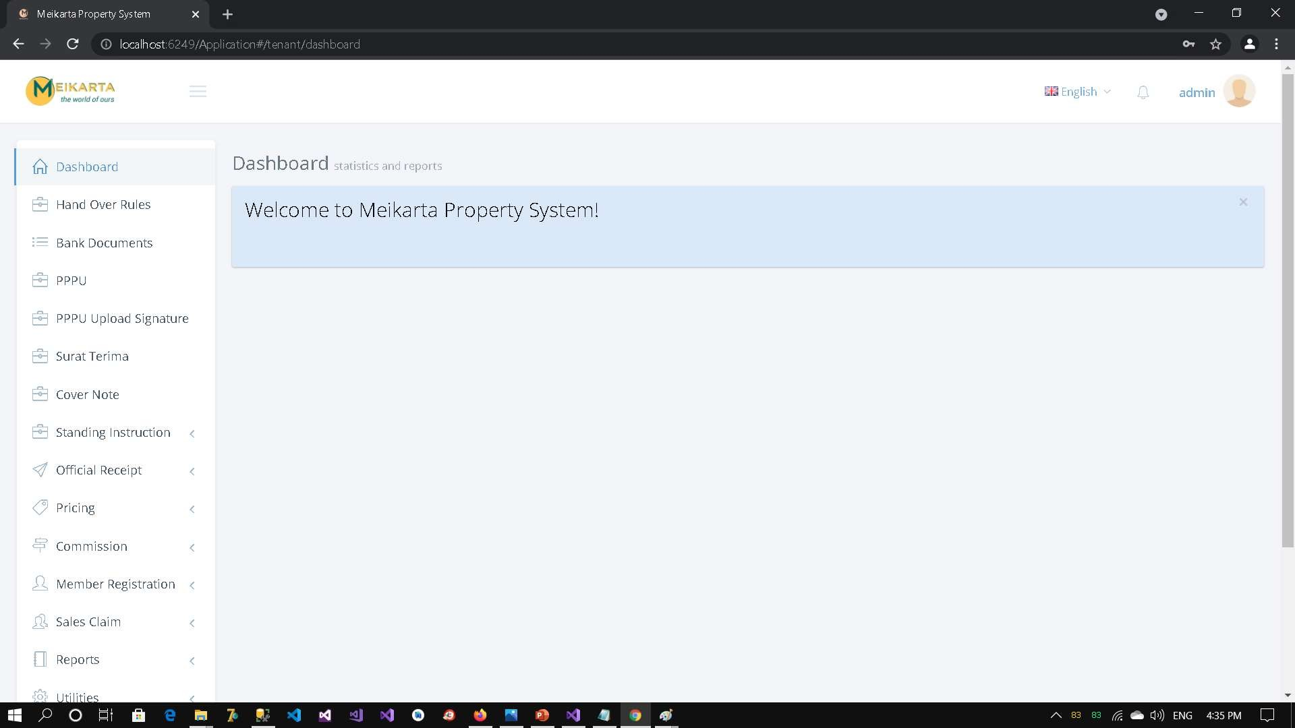
MEIKARTA PROPERTY SYSTEM

Slide 17
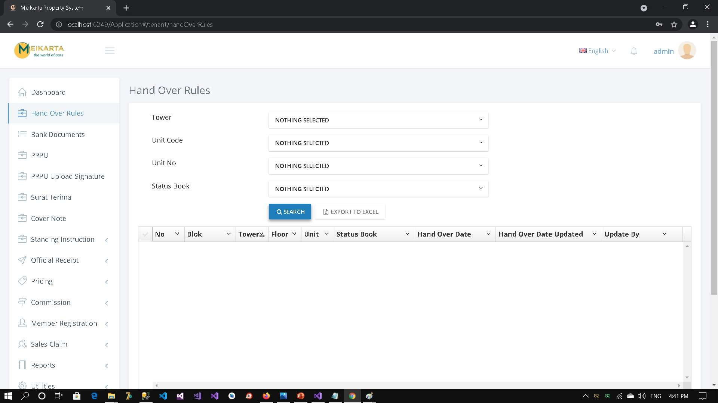
MEIKARTA PROPERTY SYSTEM

Slide 18
PROJECT DESCRIPTION
Meikarta Property System
.NET Framework 4.7
Entity Framework 6 Code Based
ADO .NET
ASP .NET MVC with C# Language
Jquery and AngularJS
WebAPI (RESTFul API)
C# for Language
SQL Server

Slide 19
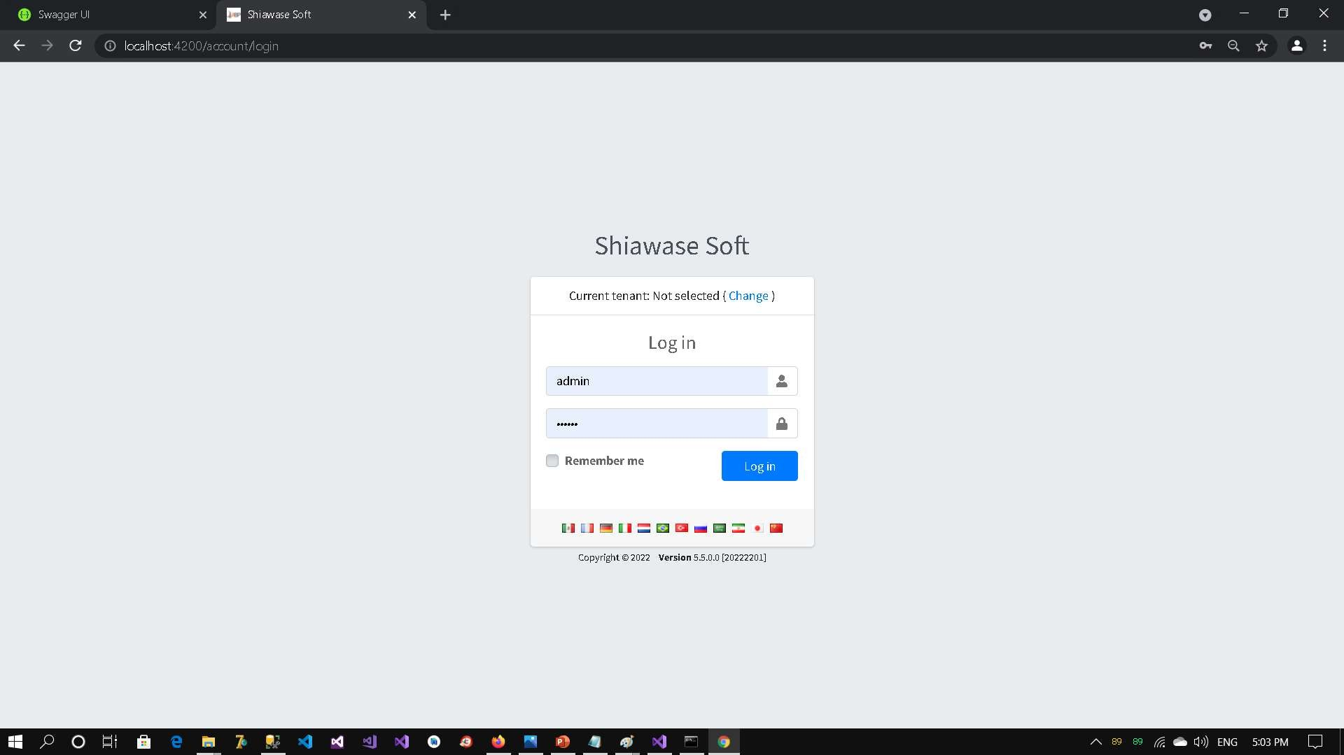
HUMAN RESOURCES

Slide 20
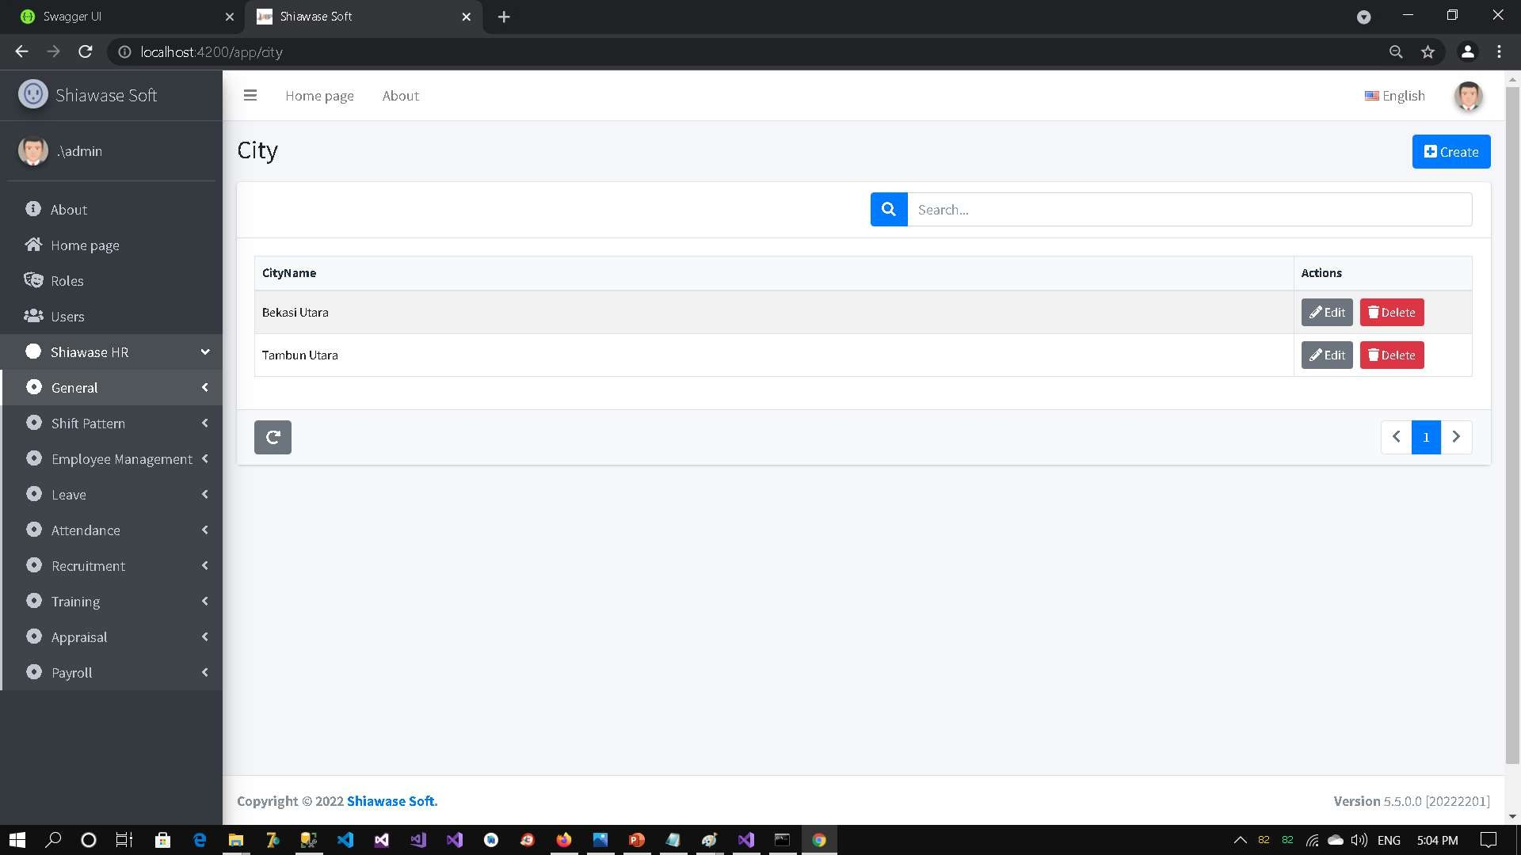
HUMAN RESOURCES

Slide 21
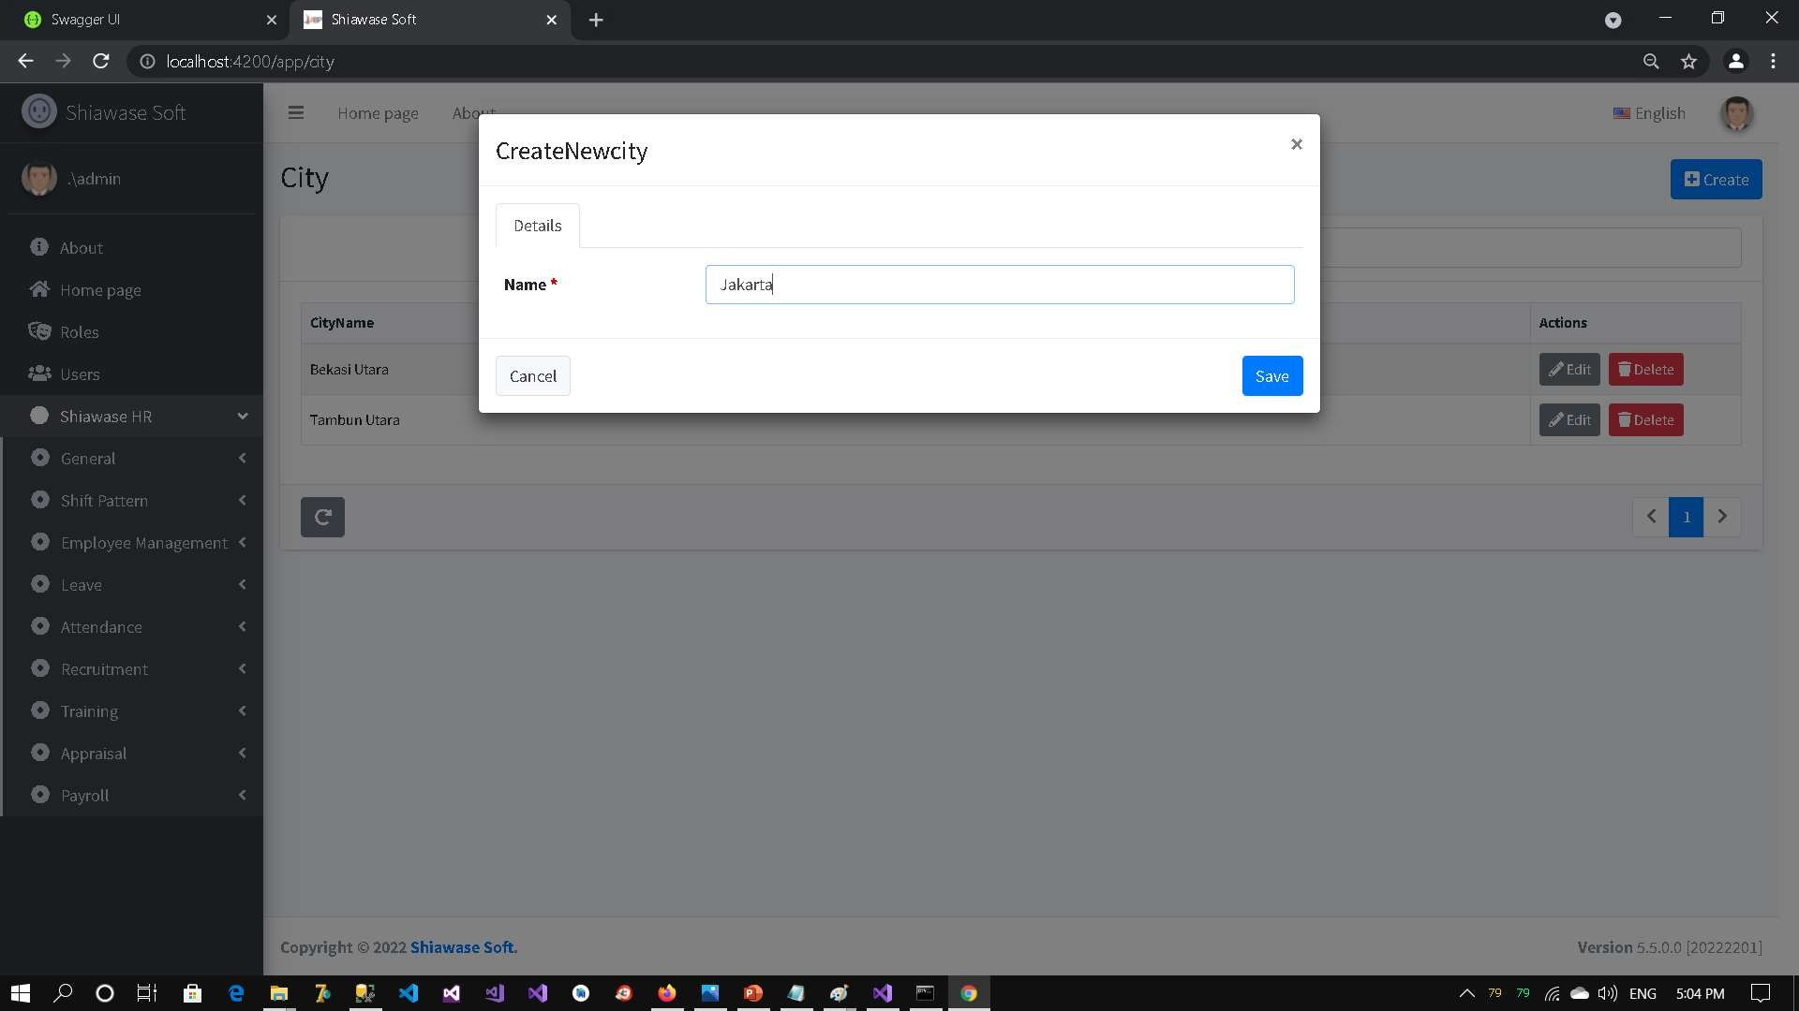
HUMAN RESOURCES

Slide 22
PROJECT DESCRIPTION
Human Resources Information System
.NET Core 5
Entity Framework Core Code Based
ASP .NET MVC with C# Language
Angular CLI and Typescript
SignalR
ABPAuth for Authorization
WebAPI (RESTFul API)
C# for Language
SQL Server

Slide 23
PROJECT DESCRIPTION
PKU Fits
.NET 4.0
Entity Framework
ASP .NET MVC with C# Language
KendoUI
JQuery
LDAP Authorization
WebAPI (RESTFul API)
C# for Language
SQL Server

Slide 24
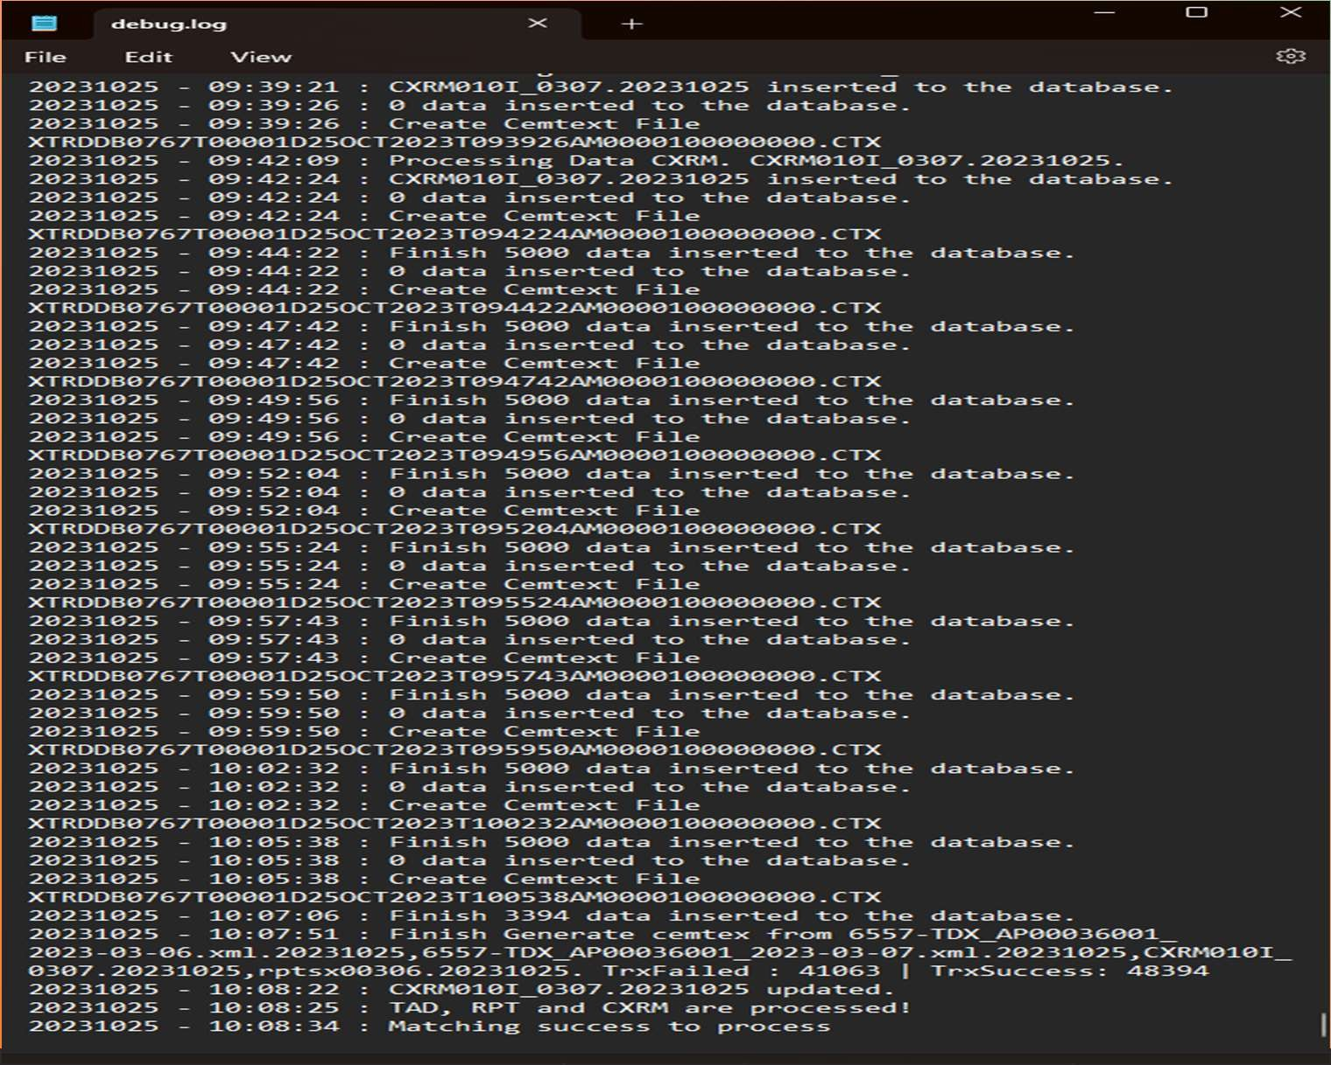



Slide 25
PROJECT DESCRIPTION
iConverter for Bank BNI
.NET Core 6
ADO .NET and Dapper ORM
OpenXML
C# for Language
SQL Server

Slide 26
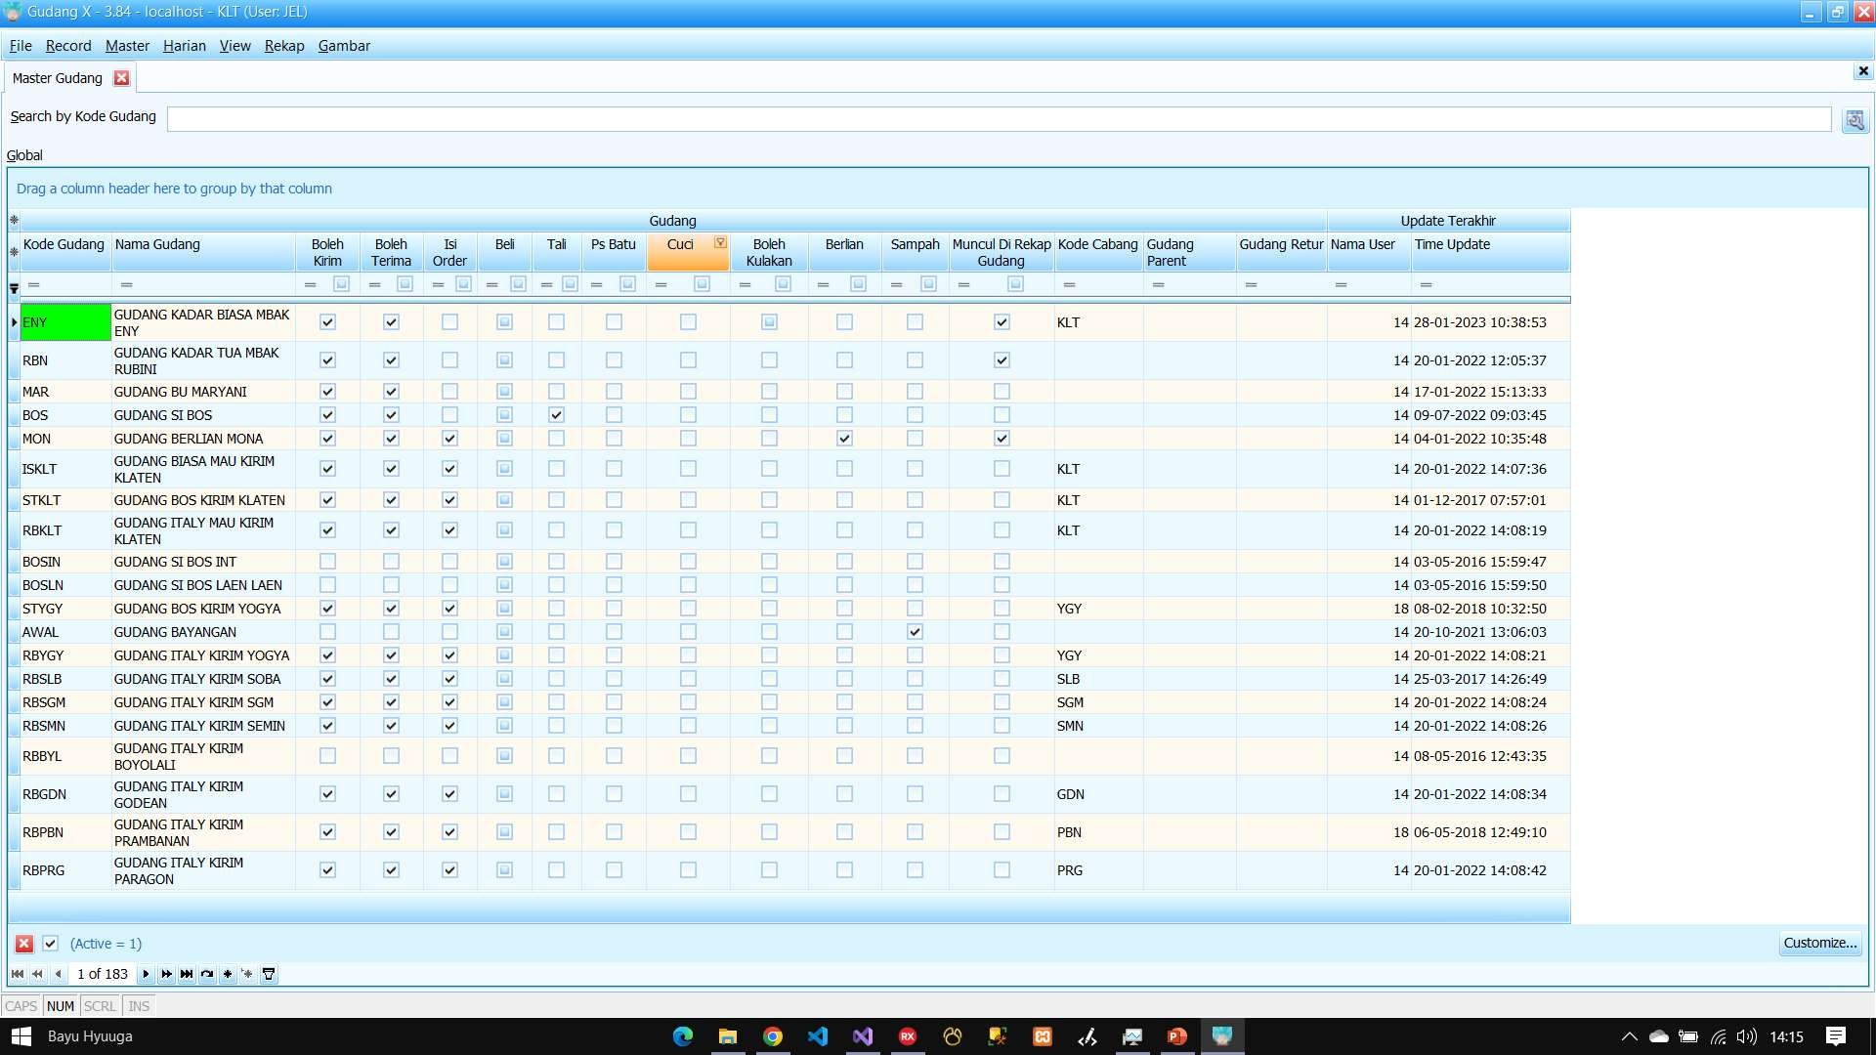

Slide 27
PROJECT DESCRIPTION
GudangX
C++Builder XE 10.3
UniDAC
DevExpress
FastReport
MySQL

Slide 28
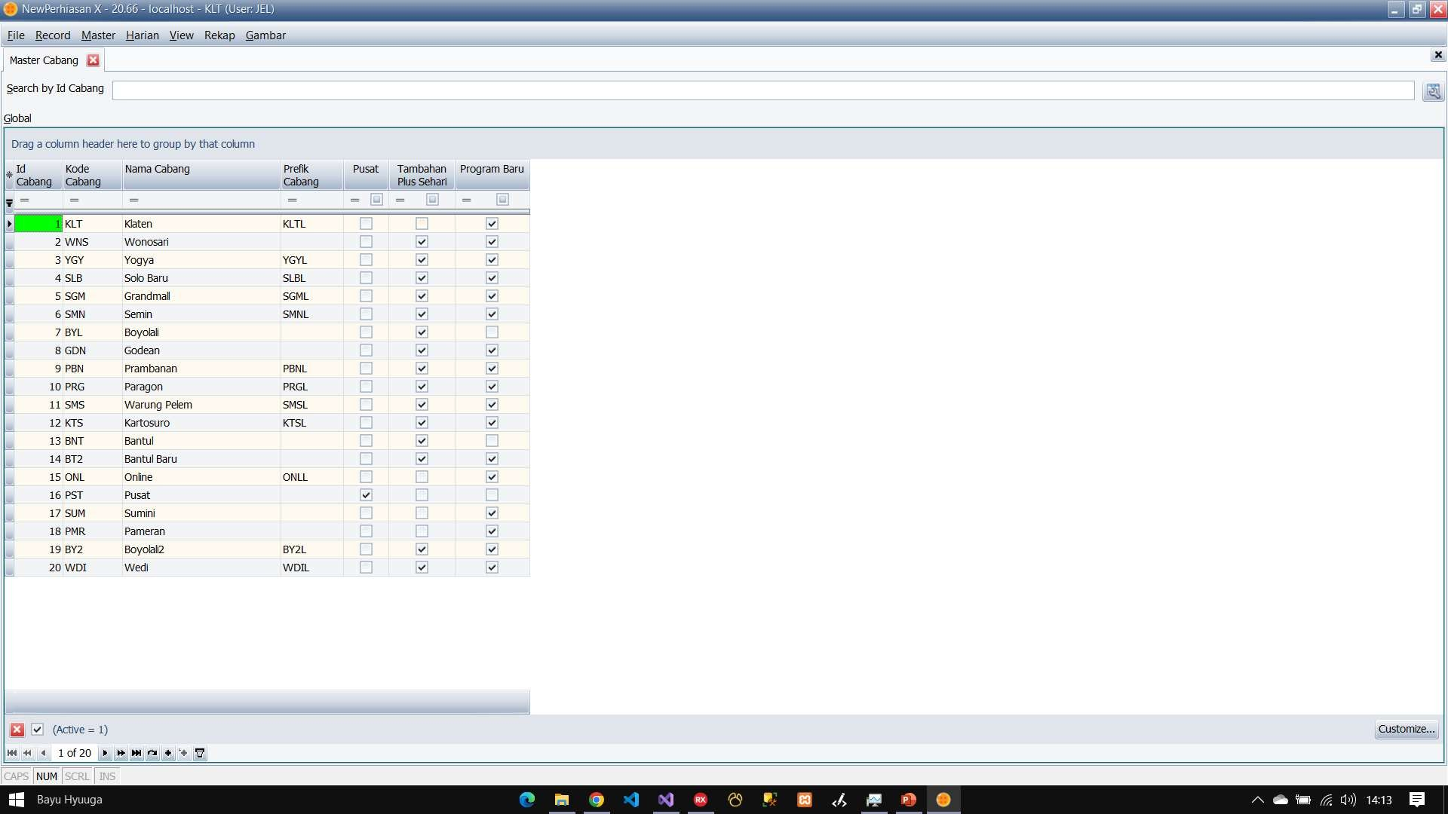

Slide 29
PROJECT DESCRIPTION
NewPerhiasanX
C++Builder XE 10.3
UniDAC
DevExpress
FastReport
MySQL

Slide 30
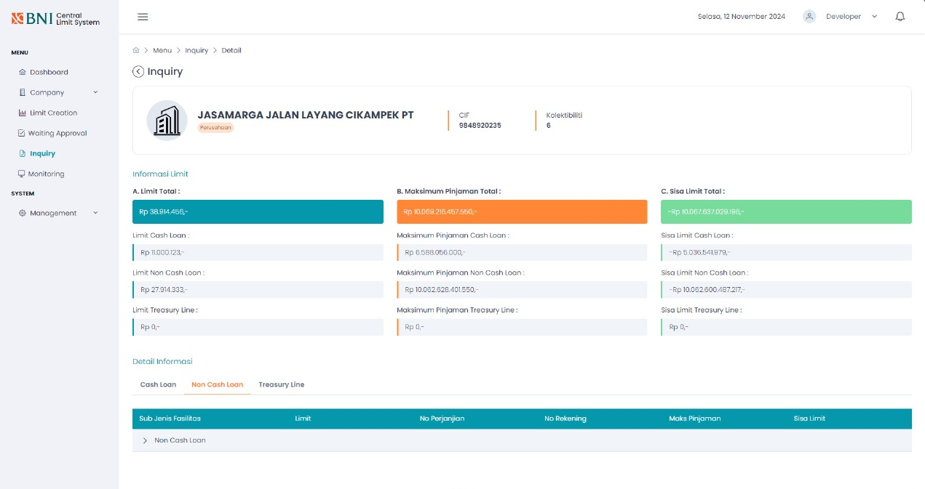
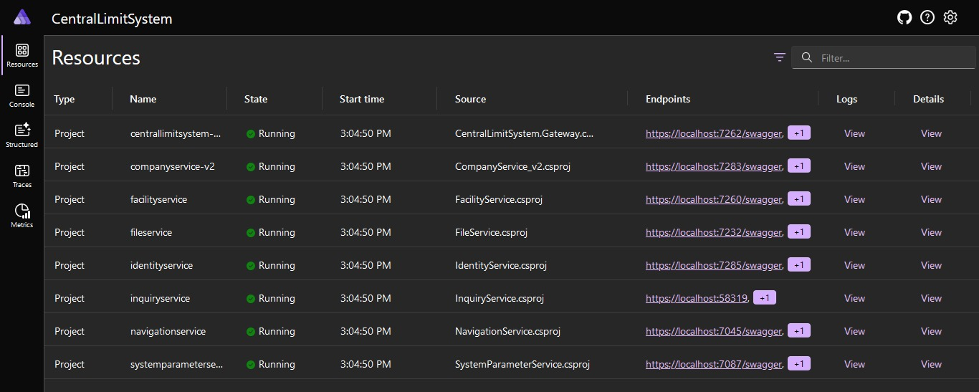

Slide 31
PROJECT DESCRIPTION
Central Limit System
.Net Core 8
.Net Aspire
EFCore
Serilog Middleware for System Logging
Audit Trail
Workflow System
Notification using SignalR
LDAP for Authentication
VueJS and ElectronJS for UI
OracleDB for Database

Slide 32
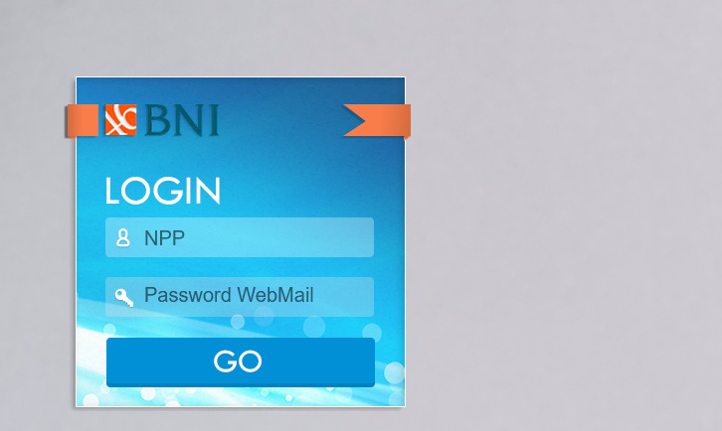

Slide 33
PROJECT DESCRIPTION
PKU Fits (Persekot)
.Net Framework 4.0
ASP .Net MVC 4
EF 6 and Dapper
Audit Trail
Workflow System
Jquery AJAX
Kendo UI
SQL Server for Database

Slide 34




Portofolio
THANK YOU
Bayu Budianto
.Net Software Developer

